Slide 1
Bio& 241 Unit 2 Lecture 2

Slide 2
Bone Tissue: Supportive Connective Tissue
CONSISTS OF FOUR TYPES OF CONNECTIVE TISSUE (CT):
Cartilage 2. Bone 3. Bone Marrow 4. Periosteum
[Osseous (bone) tissue makes up MOST of the skeleton.]
Remember “CT” is composed of:
Cells
Extracellular Matrix

Slide 4
Bone Tissue: Supportive Connective Tissue
Extracellular Matrix
25% Water
25% Protein or organic matrix
95% Collagen Fibers
5% Chondroitin Sulfate
50% Crystalized Mineral Salts
Hydroxyapatite (Calcium Phosphate crystals)
Other substances: Lead, Gold,
Strontium, Plutonium, can be incorporated in etc.
RATIO OF ORGANIC TO NON ORGANIC MATRIX:
Youth = 1:1, 50%:50%
Adult = 1:2, 33%:66%
Elderly = 1:3, 25%:75%
(bones become more brittle as we age).

Slide 5
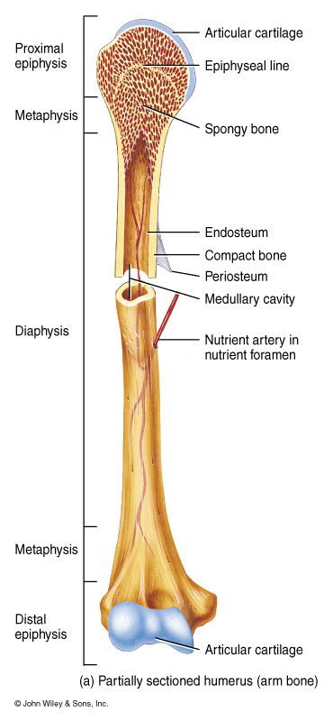
Two Kinds of Bone
Compact Bone:
1. Consists of osteons with very little space between them.
2. Composes bone tissue of the diaphysis.
FX = Protect and support
Spongy Bone:
Does NOT contain osteons.
Consist of trabeculae
Found in short, flat and irregular bones and in the epiphyses of long bones.
FX = store RED marrow.

Slide 6
Compact Bone
Compact bone is arranged in units called osteons or Haversian systems.
Osteons (Haversian canal) contain blood vessels, lymphatic vessels, nerves
Surrounding this canal are concentric rings of osteocytes along with the calcified matrix.
Osteons are aligned in the same direction along lines of stress. These lines can slowly change as the stresses on the bone changes.

Slide 7
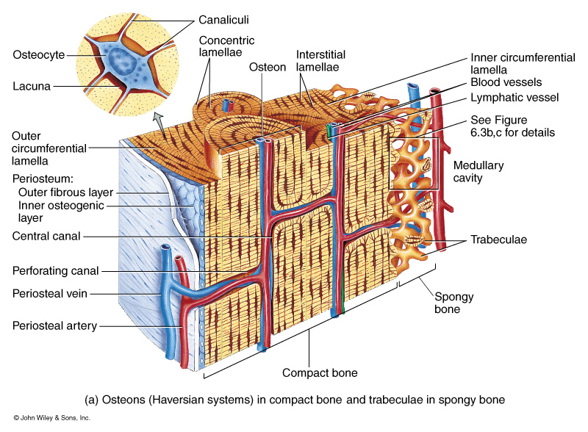
Histology of Bone Tissue

Slide 8
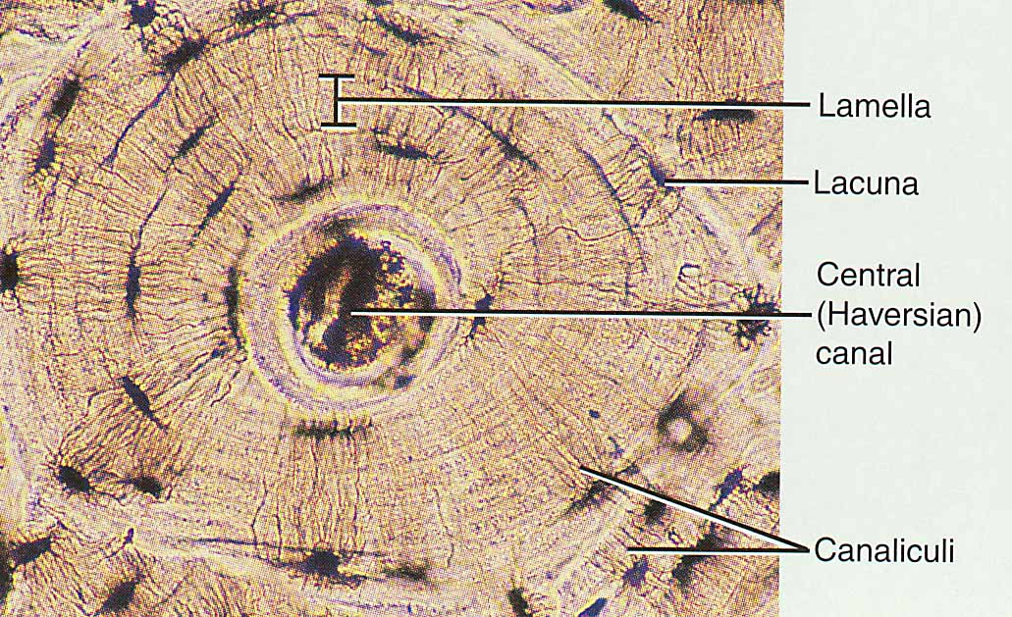
Histology of Compact Bone
Osteon is concentric rings (lamellae) of calcified matrix surrounding a vertically oriented blood vessel
Osteocytes are found in spaces called lacunae
Osteocytes communicate through canaliculi filled with extracellular fluid that connect one cell to the next cell
Interstitial lamellae represent older osteons that have been partially removed during tissue remodeling

Slide 9
Compact Bone

Slide 12
The Trabeculae of Spongy Bone
Latticework of thin plates of bone called trabeculae oriented along lines of stress
Spaces in between these struts are filled with red marrow where blood cells develop
Found in ends of long bones and inside flat bones such as the hipbones, sternum, sides of skull, and ribs.
No true Osteons.

Slide 13
BONE FORMATION
All embryonic connective tissue begins as mesenchyme.
Bone formation is termed osteogenesis or ossification and begins when mesenchymal cells provide the template for subsequent ossification.
Two types of ossification occur.
Intramembranous ossification is the formation of bone directly from or within fibrous connective tissue membranes.
Endochondrial ossification is the formation of bone from hyaline cartilage models.

Slide 14
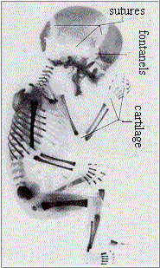
Two Kinds of Ossification
1. Intramembranous Ossification
2. Endochondral Ossification

Slide 15
Intramembranous Ossification
Also called dermal ossification because it normally occurs in the deeper layers of connective tissue of the dermis of the skin.
All roofing bones of the Skull
Frontal bone
Parietal bones
Occipital bone
Temporal bones
Mandible
Clavicle

Slide 16
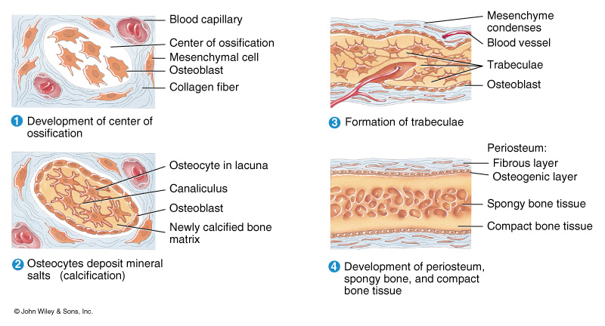
Intramembranous Ossification

Slide 17
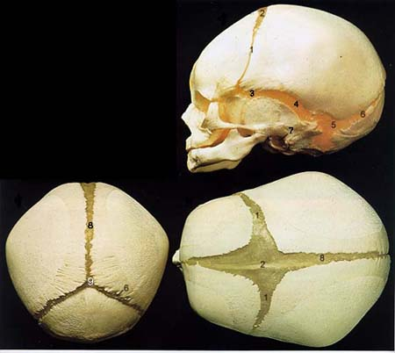
Centers of Ossification
Centers of Ossification

Slide 18
Endochondral Ossification
Developing bones are deposited as a hyaline cartilage model and then this cartilage is replaced by bone tissue.
All bones of the body except:
All roofing bones of the Skull
Mandible
Clavicle

Slide 19
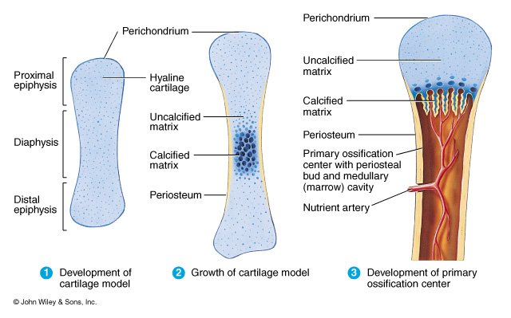
Endochondral Ossification

Slide 20
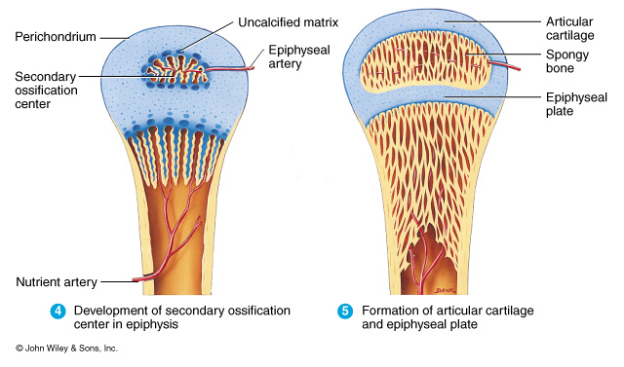
Endochondral Ossification

Slide 22
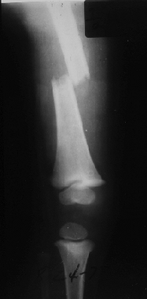
Growth at epiphyseal plates
Zones of epiphyseal plates
Zone of Resting Cartilage
Zone of Proliferating Cartilage
Zone of Hypertrophic Cartilage
Zone of Calcified Cartilage

Slide 23
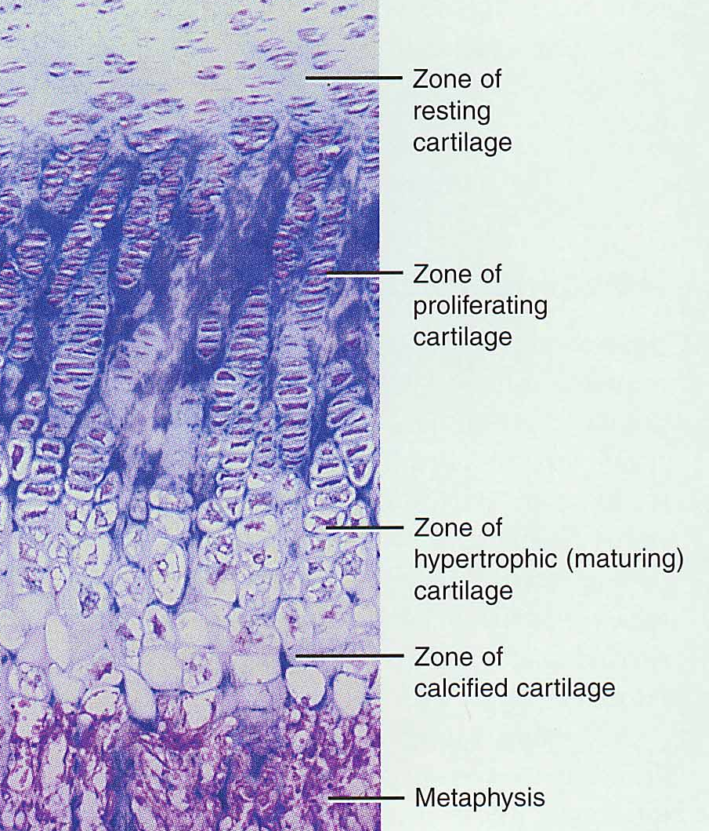
Zones of Growth in Epiphyseal Plate
Zone of resting cartilage
anchors growth plate to bone
Zone of proliferating cartilage
rapid cell division (stacked coins)
Zone of hypertrophic cartilage
cells enlarged & remain in columns
Zone of calcified cartilage
thin zone, cells mostly dead since matrix calcified
osteoclasts removing matrix
osteoblasts & capillaries move in to create bone over calcified cartilage

Slide 24
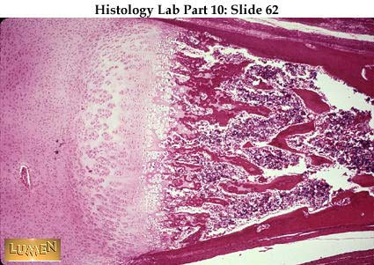
Growth at epiphyseal plates
Zones of epiphyseal plates
Zone of Resting Cartilage
Zone of Proliferating Cartilage
Zone of Hypertrophic Cartilage
Zone of Calcified Cartilage

Slide 25
Growth at epiphyseal plates
Zones of epiphyseal plates
Zone of Resting Cartilage
Zone of Proliferating Cartilage
Zone of Hypertrophic Cartilage
Zone of Calcified Cartilage

Slide 26
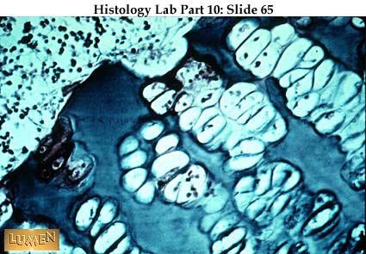

Slide 27
Growth at epiphyseal plates
Zones of epiphyseal plates
Zone of Resting Cartilage
Zone of Proliferating Cartilage
Zone of Hypertrophic Cartilage
Zone of Calcified Cartilage

Slide 28
Growth at epiphyseal plates
Zones of epiphyseal plates
Zone of Resting Cartilage
Zone of Proliferating Cartilage
Zone of Hypertrophic Cartilage
Zone of Calcified Cartilage

Slide 29
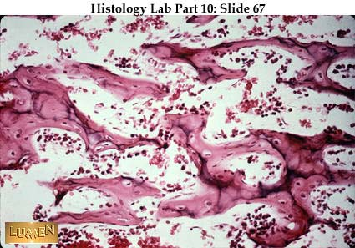

Slide 30
Growth in Thickness
Bone can grow in thickness or diameter only by appositional growth.
The steps in these process are:
Periosteal cells differentiate into osteoblasts which secrete collagen fibers and organic molecules to form the matrix.
Ridges fuse and the periosteum becomes the endosteum.
New concentric lamellae are formed.
Osetoblasts under the peritsteum form new circumferential lamellae.

Slide 31
Bone Growth in Width
Only by appositional growth at the bone’s surface
Periosteal cells differentiate into osteoblasts and form bony ridges and then a tunnel around periosteal blood vessel.
Concentric lamellae fill in the tunnel to form an osteon.

Slide 32
Factors That Affect Bone Growth
Minerals
Vitamins
Hormones
Exercise

Slide 33
Factors That Affect Bone Growth
Minerals
Calcium Makes bone matrix hard
Hypocalcemia: low blood calcium levels.
Hypercalcemia: high blood calcium levels.
Dietary Source | Serving size | Amount in (mg)
Yogurt (fat free/low fat) | 8oz | 487/447
Sardines | 3.75oz | 351
Ricotta cheese | ½ cup | 337
Skim milk | 8oz | 302
Orange juice (fortified) | 8oz | 300
Low fat Milk (1%) | 8oz | 300
Dried figs | 10 | 270

Slide 34
Age | Amount of Calcium
Infants
Birth - 6 months | 210 mg
6 months - 1 year | 270 mg
Children/Young Adults
1 - 3 years | 500 mg
4 - 8 years | 800 mg
9 - 18 years | 1,300 mg
Adult Women & Men
19 - 50 years | 1,000 mg
50 + | 1,200 mg
Pregnant or Lactating
18 years or younger | 1,300 mg
19 - 50 years | 1,000 mg
Source: National Academy of Sciences 1997.

Slide 35
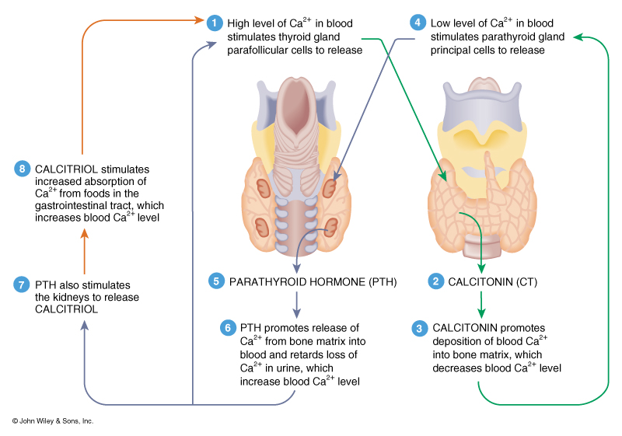
Calcium Homeostasis

Slide 36
Nutrient | Effect on Bone Development | Dietary Source
Boron | Enhances calcium absorption and estrogen metabolism | avocado, nuts, peanuts, and prune juice
Fluoride | Stimulates bone and tooth development | fluoridated water, marine fish, teas, dental products
Magnesium | Enhances bone quality and improves bone density | green leafy vegetables, potatoes, nuts, seeds, whole grains, bananas
Phosphorus | Combines with calcium to form Hydroxyapatite | milk, yogurt, ice cream, peas, eggs, meat, breads
Manganese | Acts a coenzyme to form optimal bone matrix | Nuts, legumes, tea, whole grains

Slide 37
Factors That Affect Bone Growth
Vitamins
Vitamin A Controls activity, distribution, and coordination of osteoblasts/osteoclasts
Vitamin B12 May inhibit osteoblast activity
Vitamin C Helps maintain bone matrix, deficiency leads to decreased collagen production which inhibits bone growth and repair
(scury) disorder due to a lack of Vitamin C
Vitamin D (Calcitriol) Helps build bone by increasing calcium absorption.
Deficiencies result in “Rickets” in children

Slide 38
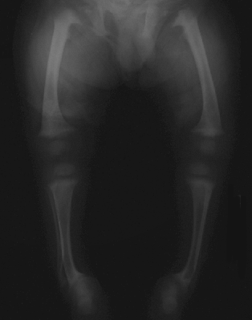

Slide 39
Factors That Affect Bone Growth
Hormones
Human Growth Hormone Promotes general growth of all body tissue and normal growth in children
Insulin-like Growth Factor Stimulates uptake of amino acids and protein synthesis
Insulin Promotes normal bone growth and maturity
Thyroid Hormones Promotes normal bone growth and maturity
Estrogen and Increases osteogenesis at puberty Testosterone and is responsible for gender differences of skeletons

Slide 40
Bone Fractures
Closed fracture: one that does not produce an open wound in the skin
Open fracture: one in which a wound through the adjacent or overlying soft tissues communicates with the site of the break.
Compound fracture: A fracture in which the bone is sticking through the skin. Also has been called an open fracture.
Simple fracture : an uncomplicated fracture in which the broken bones to not pierce the skin. Also has been called a closed fracture.
Comminuted fracture: The bone is splintered or crushed, Can be viewed as a “closed compound fracture”

Slide 41
Bone Fractures
Colles' fracture: fracture of the lower end of the radius, the lower fragment being displaced backward
Greenstick fracture: one side of a bone is broken, the other being bent. Most common in children.
Impacted fracture one bone fragment is firmly driven into the other. Common with vertebra.
Pathologic fracture: due to weakening of the bone structure by pathologic processes, such as neoplasia, osteomalacia, or osteomyelitis
Pott's fracture: fracture of the lower part of the fibula, with serious injury of the lower tibial articulation, usually a chipping off of a portion of the medial malleolus, or rupture of the medial ligament

Slide 42
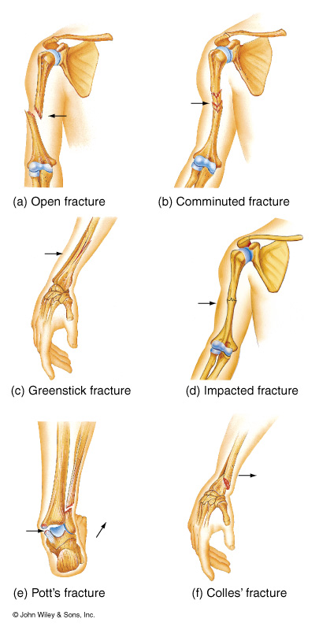
Bone Fractures
Terms:
Partial/Complete
Displaced/Non-displaced
Other Fractures:
Spiral
Transverse
Longitudinal
Pathologic

Slide 43
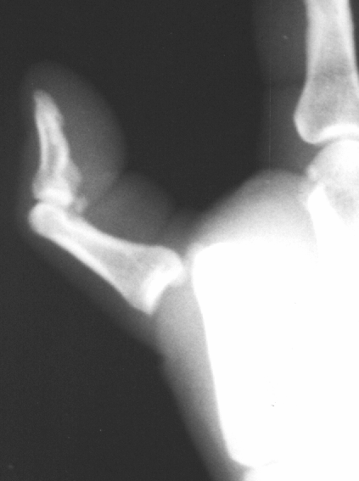
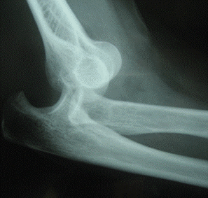
Dislocations
Subluxation : an incomplete or
partial dislocation of a joint or organ.
Luxation: a complete dislocation of
A joint or organ.

Slide 44
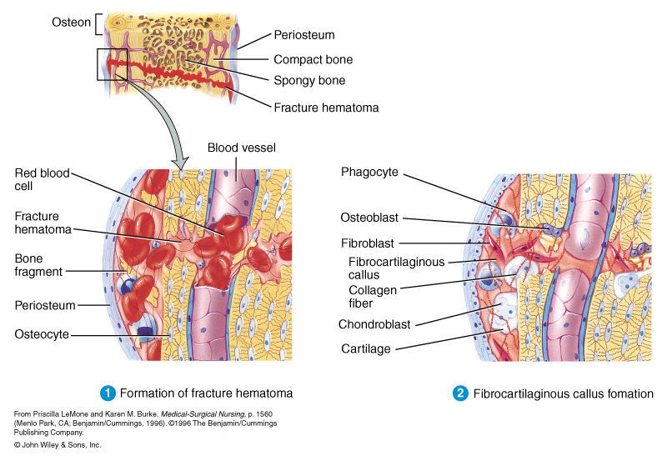
Bone Fracture Repair

Slide 45
Steps in Fracture Repair
1. Formation of a fracture hematoma
Immediately after the fracture, there is
a sharp fracture line with associated
soft tissue swelling. At the fracture
Site, there is abundant hematoma
with beginning fibroblastic penetration.

Slide 46
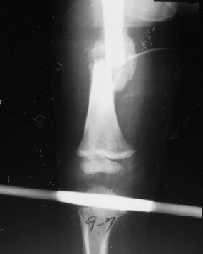
Steps in Fracture Repair
Fibrocartilaginous Callus
Formation
At 2 weeks there is much visible callus.
There is also bone resorption and
osteoporosis, both difficult to see in
this case because of the overlying callus.
There has been migration of chondroblasts
into the area and cartilage is beginning
to cover the ends of the fracture. New
osteous tissue is produced
enchondrally.

Slide 47
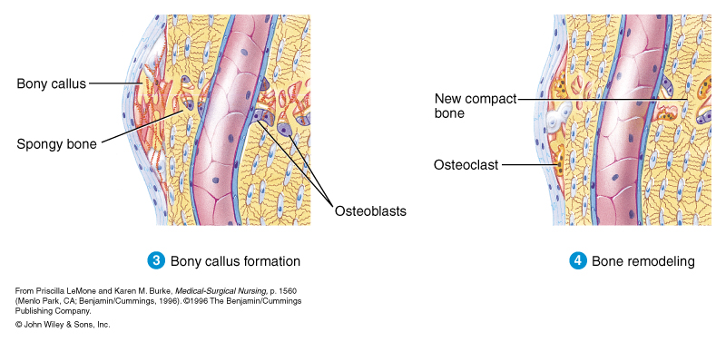
Bone Fracture Repair

Slide 48
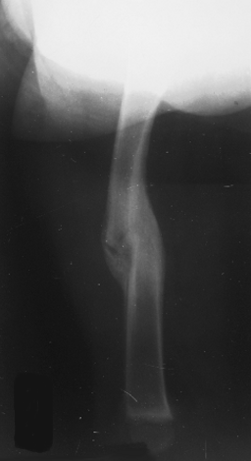
Steps in Fracture Repair
3. Bony Callus Formation
At 2 months, bony callus with sharp margins bridges the fracture and the fracture line itself begins to disappear.

Slide 49
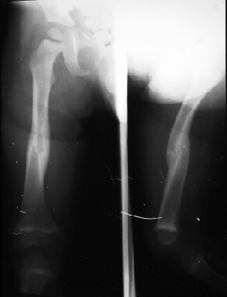
Steps in Fracture Repair
4. Bone Remodeling
At 5-6 months, the marrow cavity
is continuous and the compact bone
of the diaphysis has been reformed.

Slide 50
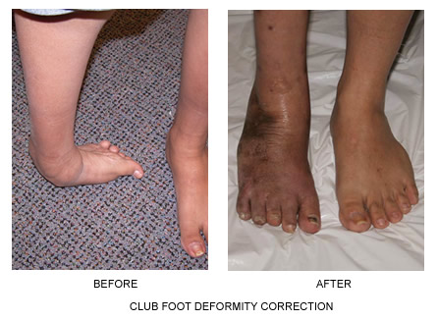
Congenital Skeletal Birth Defects
Congenital Talipes Equinovarus (CTEV),[
occurs in about one in every 1,000 live births.
Approximately 50% of cases of clubfoot are bilateral
Occurs in males more often than in females by a ratio of 2:1.

Slide 51
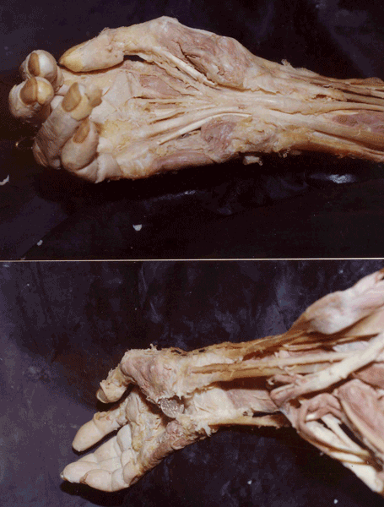
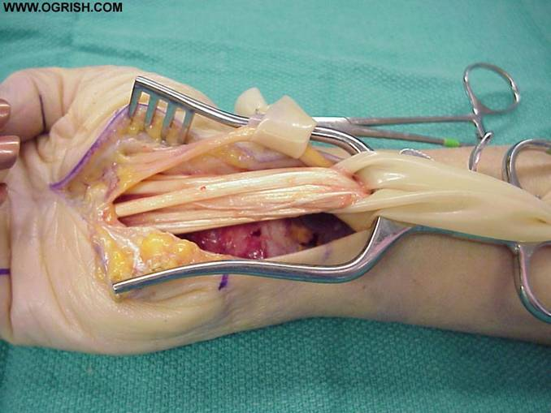
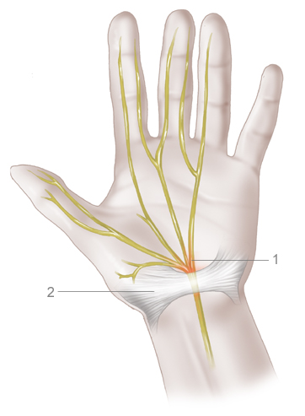
compression of the median nerve as it passes through the carpal tunnel
in the wrist. Signs and symptoms include pain in the hand and wrist
associated with tingling and numbness,
distributed along the median nerve (palm side of thumb, index and middle fingers and
possibly ½ of the ring finger

Slide 52
Bone Disorders
Osteopenia: Refers to bone mineral density (BMD) that is lower than normal peak BMD but not low enough to be classified as osteoporosis
Osteoporosis: Loss of both bone salts and collagen fibers. Increased osteoclast activity and decreased osteoblast activity
Risk Factors:
European/Asian ancestry Family history Small body build
Inactive lifestyle Cigarette smoking early menopause
excessive use of alcohol a diet low in calcium advanced age
(African American and Hispanic women are at lower but significant risk)
prolonged use of certain medications, such as those used to treat lupus, asthma, thyroid deficiencies, and seizures.

Slide 53
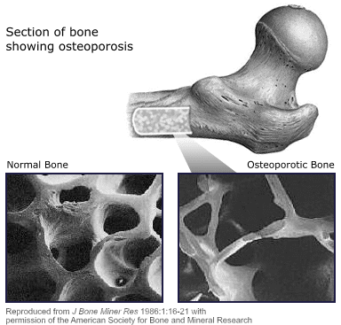

Slide 54
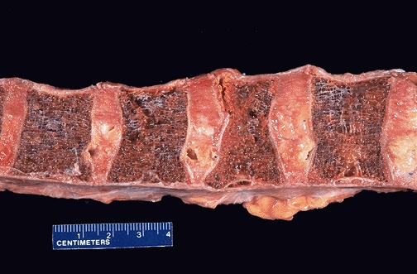

Slide 55
Bone Disorders
Osteomalacia: Loss of bone salts but not collagen (demineralization) due to poor diet, decreased absorption of calcium, and vitamin D deficiency. Basically a demineralization of bone
Example: Rickets in young children

Slide 56
Bone Disorders
Paget’s Disease: Abnormal bone remodeling resulting in irregular thickening and thinning of bone through remodeling
Osteomyelitis: Infection of bone most commonly by Staphylococcus aureus
Osteogenic sarcoma: Bone cancer that affects osteoblasts at the metaphyses of long bones. Most common in teenagers

Slide 57
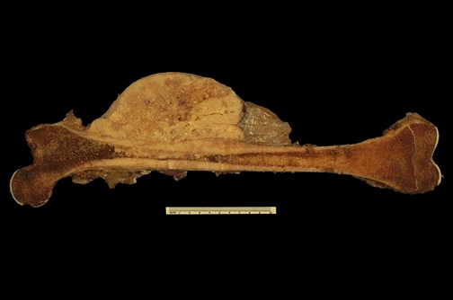

Slide 58
Bone Disorders
Arthritis:
Osteoarthritis: “DJD” degenerative joint disease
Inflammatory Joint Disease:
Rheumatoid arthritis: Initially may be caused by transient infection that results in autoimmune attacks against collagen in the bones at joints.
Gouty Arthritis: Build-up of uric acid in the joints due to metabolic problems with handling the amino acid cystine.

Slide 59
Rheumatoid Arthritis
Rheumatoid arthritis is a chronic inflammatory disorder that most typically affects the small joints in your hands and feet. Unlike the wear-and-tear damage of osteoarthritis, rheumatoid arthritis affects the lining of your joints, causing a painful swelling that can eventually result in bone erosion and joint deformity.
Risk factors
Sex. Women are more likely to develop rheumatoid arthritis than men are.
Age. Rheumatoid arthritis can occur at any age, but it most commonly begins between the ages of 40 and 60.
Family history. If a member of your family has rheumatoid arthritis, you may have an increased risk of the disease..
Smoking. Smoking cigarettes increases your risk of rheumatoid arthritis. Quitting can reduce your risk.

Slide 60
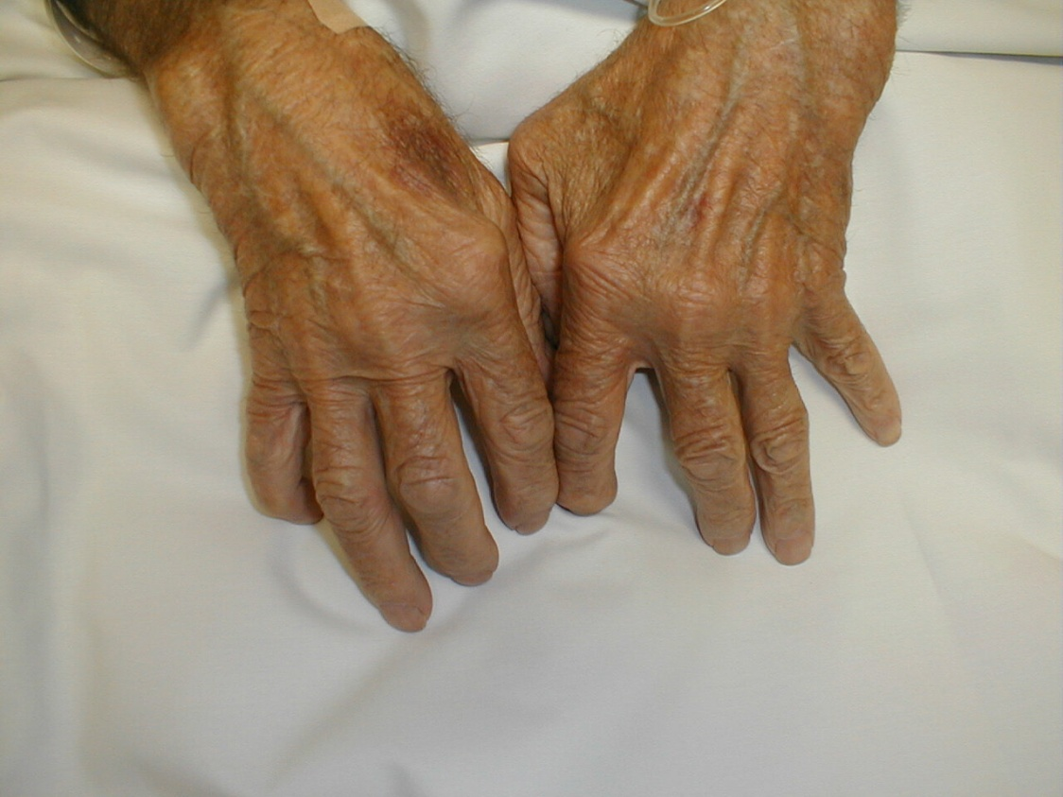

Slide 61
Bone Disorders
Infectious arthritis: Lyme's disease
Lyme disease is the most common tick-borne disease in the Northern Hemisphere. It is caused by at least three species of bacteria belonging to the genus Borrelia, Borrelia burgdorferi is the predominant cause of Lyme disease in the United States, whereas Borrelia afzelii and Borrelia garinii are implicated in most European cases.
Borrelia is transmitted to humans by the bite of infected hard ticks belonging to several species of the genus Ixodes. Early manifestations of infection may include fever, headache, fatigue, depression, and a characteristic skin rash called erythema migrans. Left untreated, late manifestations involving the joints, heart, and nervous system can occur. In a majority of cases, symptoms can be eliminated with antibiotics, especially if diagnosis and treatment occur early in the course of illness. Late, delayed, or inadequate treatment can lead to late manifestations of Lyme disease which can be disabling and difficult to treat.
The disease only became apparent in 1975 when mothers of a group of children who lived near each other in Lyme, Connecticut, made researchers aware that their children all were diagnosed with rheumatoid arthritis.

Slide 62
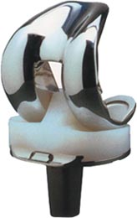
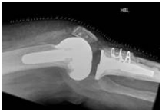
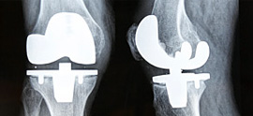
Total Knee Replacement.

Slide 63
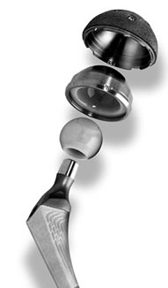
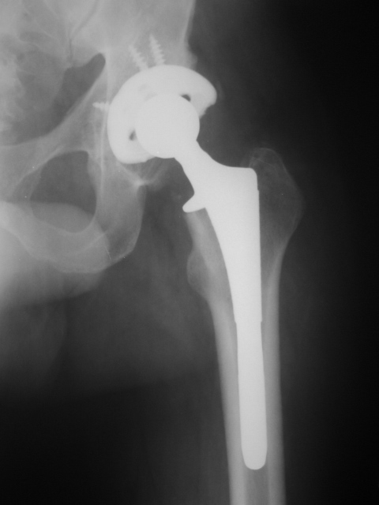
Hip Replacement

